Slide 1
Introduction to the Mini-International Neuropsychiatric Interview (M.I.N.I.)
Nview Health Enables Physician Practices to Deliver Validated Diagnostic Behavioral Health Screens, Interviews, Outcome Tracking and Services to Patients in a Simple and Easy-to-Bill Platform.
Integrated Behavioral Health Solutions

Slide 2
About Nview Health
Integrated Behavioral Health Solutions
Privately Held Delaware Corporation
Offices in Jacksonville, FL, and San Diego, CA
Ownership of Dr. Sheehan’s intellectual property rights
Continuing to develop new technology and products including tools for Cognitive assessment

Slide 3
Today: National Institute of Health Facts
1 in 5
Adults Will Experience
A Diagnosable Mental
Illness This Year
Health
Systems
Impact on Stakeholders
Patients
And
Families
Behavioral
Health
Impact
Payors
$
Estimated
$465B
Annual Economic Impact
Community
Employers

Slide 4
Comorbid Mental Medical Conditions
In any given year, there are approximately
34 Million
American adults
with co-morbid mental and medical conditions.
Coordinating Care Can:
Improve Clinical Outcomes
Increase Quality of Care
Reduce Costs
Boost Consumer Satisfaction

Slide 5
Economic Burden
The fact is most chronic illnesses are at least twice as expensive to treat with a missed, under-diagnosed or untreated mental health comorbidity.
COMORBID DEPRESSION
Annual Medical Cost (in thousands)
With Treated Without Treated
Disorder Mental Illness Mental Illness
Heart Failure $2.56 $6.74
Allergic Rhinitis $3.27 $8.46
Asthma $3.73 $10.56
Migraine $3.82 $15.47
Back Pain $11.61 $33.25
Diabetes $13.06 $27.28
Hypertension $13.38 $27.06
Ischemic Heart Disease $62.40 $110.94
Costs per patient, based on claims data for 229,776 patients, 2004 – 2006 Source - OCI 2008
54% Increase in monthly health care expenditures for those with chronic conditions and comorbid depression.
Without Depression
With Depression
COMORBID ANXIETY
67% Increase in monthly health care expenditures for those with chronic conditions and comorbid anxiety.
Without Anxiety
With Anxiety

Slide 6
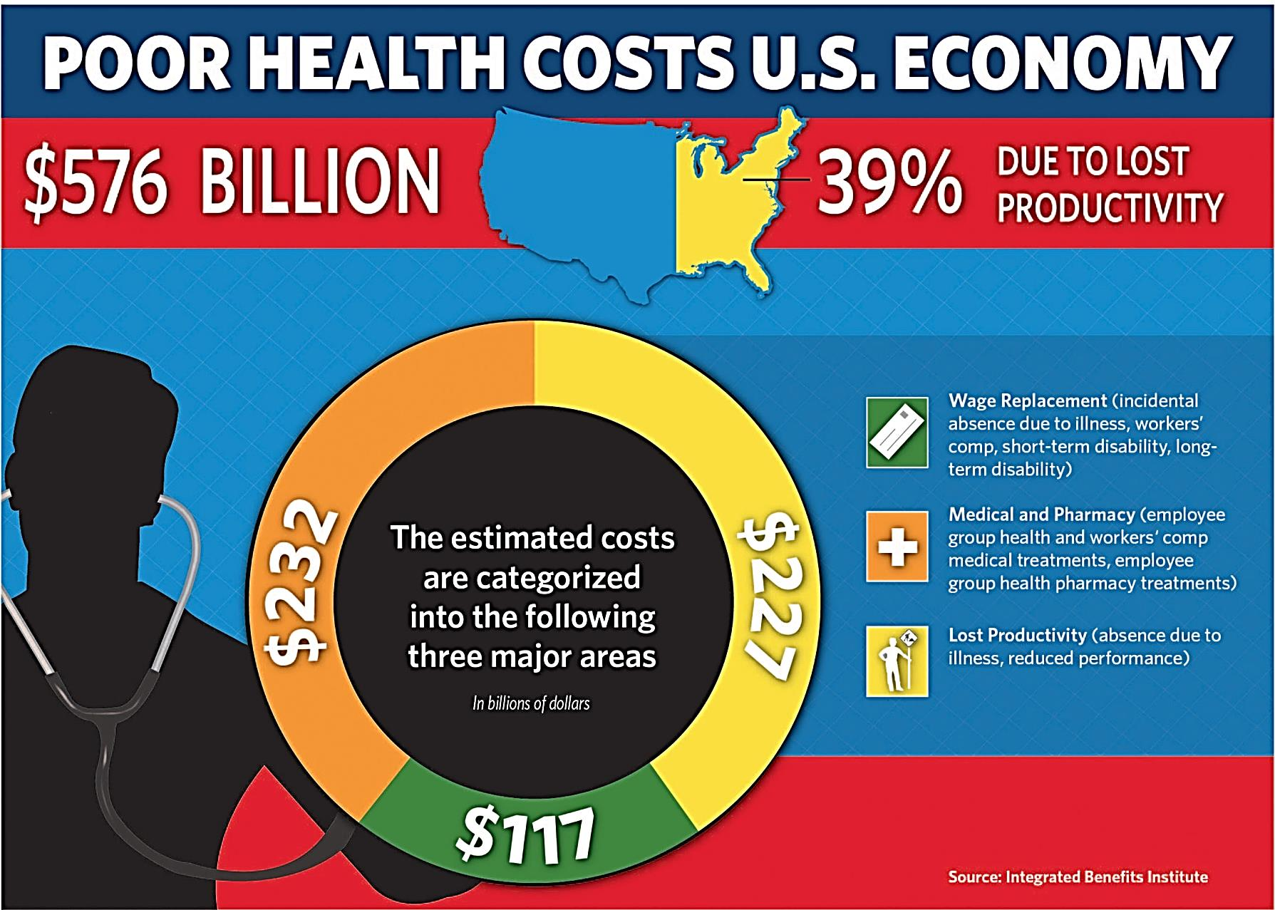
Total Burden - It Effects All of Us
Source: 2015 Integrated Benefits Institute

Slide 7
Suicide Impact on Primary Care
Up to 45% of individuals who die by suicide have visited their primary care physician within a month of their death.
Up to 67% of those who attempt suicide receive medical attention as a result of their attempt.
Approximately 13 family practice patients attempt suicide annually; physicians are only aware of 1 – 2.
Primary care has enormous potential to help prevent suicides and connect people to needed specialty care.
http://www.ncbi.nlm.nih.gov/pmc/articles/PMC419387/

Slide 8
Diagnostic Accuracy
Statistics from the National Institutes of Health show
Two-thirds of all mental health diagnoses and treatments come from the primary care doctor and pediatric primary care doctors.
Yet, the study shows, they struggle to get it right with misdiagnosis rates reaching:
97.8% Social Anxiety Disorder
92.7% Bipolar Disorder
85.8% Panic Disorder
65.9% Major Depressive Disorder
71.0% Generalized Anxiety Disorder
NIH published diagnosis rate for the M.I.N.I. is 89%.

Slide 9
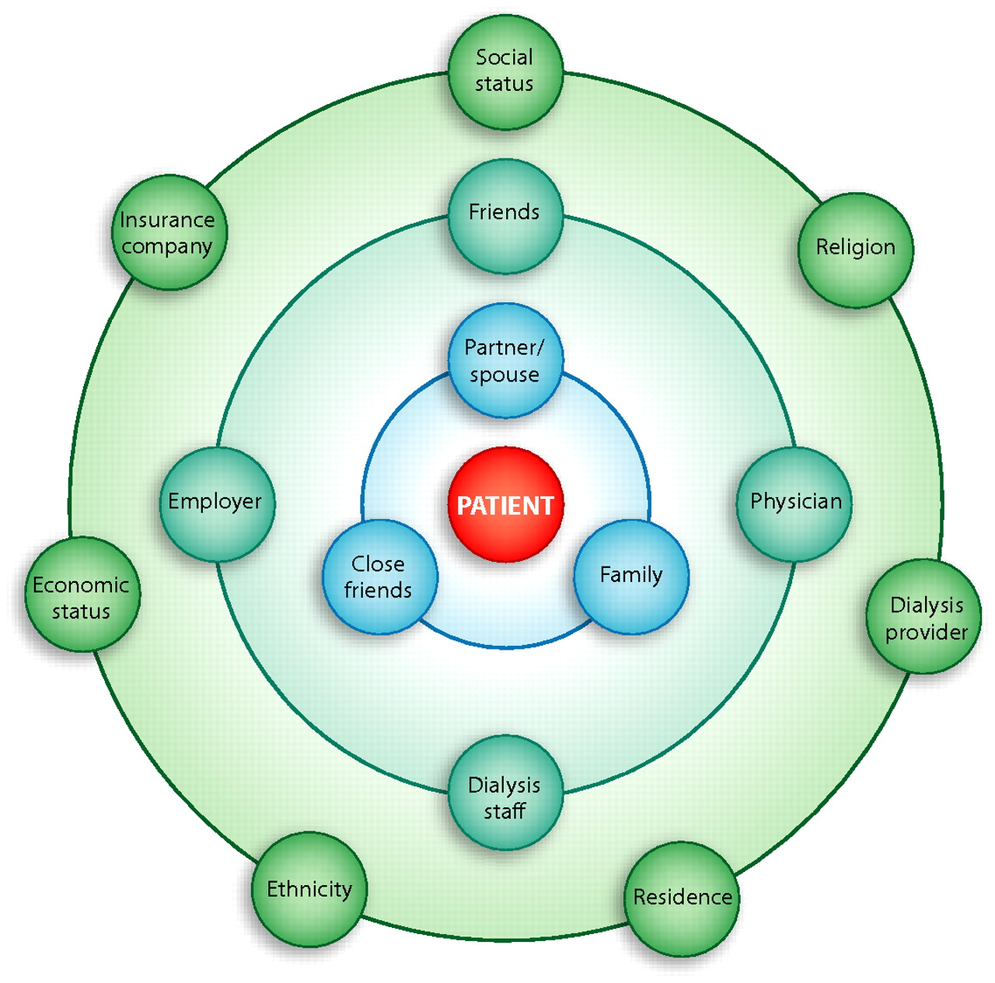
Psychosocial Parameters: Spheres of influence.
Daniel Cukor et al. JASN 2007;18:3042-3055
Notes:
Psychosocial parameters: Spheres of influence.

Slide 10
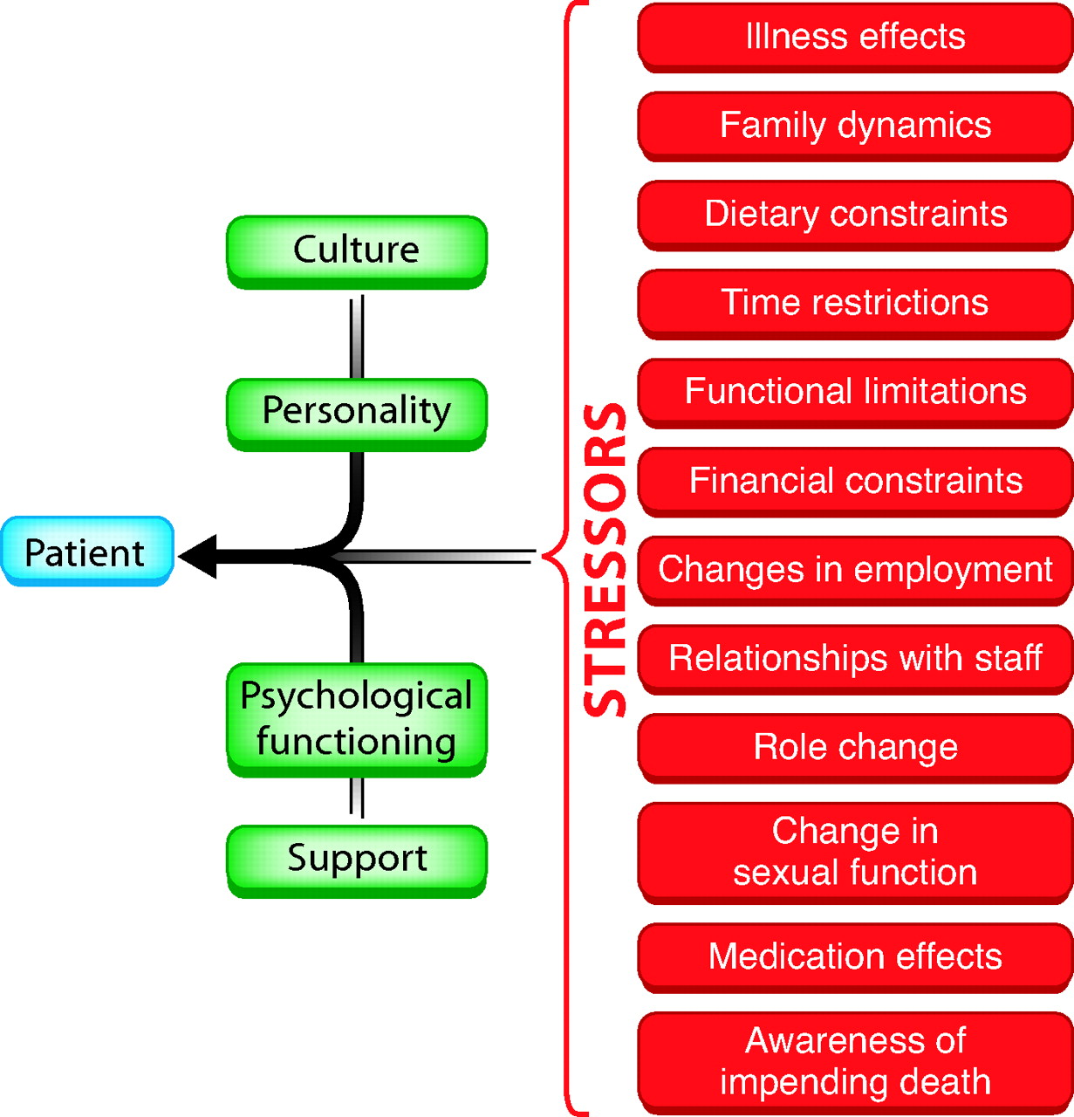
Patient characteristics and stressors that may affect perceived stress in CKD Patients.
Daniel Cukor et al. JASN 2007;18:3042-3055
Notes:
Patient characteristics and stressors that may affect perceived stress in CKD patients.

Slide 11
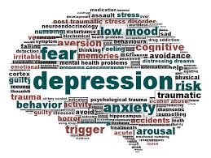
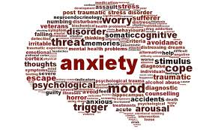
What Are the feelings and Does it Matter ?
.

Slide 12
Cause or Result
There is increasing evidence supporting a role for psychosocial factors such as depression, anxiety, and perceived social support, in the pathophysiology of various chronic diseases, including CKD, where depressive disorders have been found to be associated with an increased risk of mortality, and poor health-related quality of life
McKercher, C., Sanderson, K. and Jose, M.D. (2013) Psychosocial Factors in People with Chronic Kidney Disease
Prior to Renal Replacement Therapy. Nephrology, 18, 585-591.

Slide 13
Anxiety is also a Major issues in Patients with CKD
Extreme anxiety and anxiety somatic symptoms such as breathlessness, palpitations, chest pain, sweating and fear of dying may occur in renal failure cases.
This is the primary cause of unexplained ER visits and readmissions
There are multiple medical issues and possible complications a patient must adapt to
Medication management is paramount if the anxiety is to be controlled.
Notes:
Many a times, these symptoms are not associated with any triggers and may occur unexpectedly. There are, on the other hand, many reasons regarding the occurrence of anxiety. The process of dialysis and a multitude of potential medical complications give the patient a lot to worry and anticipate about. Pharmacological management is paramount in the management of anxiety and panic. Benzodiazepines such as clonazepam and alprazolam may be used to reduce anxiety in such patients. Many patients with anxiety also tend to experience insomnia. Drugs such as zolpidem and zaleplon are useful in the management of such inAnti-anxiety drugs and renal failure
Drug Dose in normal adults (mg/day) Dose in renal failure (mg/day) Comment
Alprazolam38 0.25-4 mg 0.25-2 mg Effective in the management of anxiety and insomnia. May cause drowsiness at high doses that may be confused with delirium
Clonazepam39 0.5-1.5 mg 0.5-1.5 mg
Lorazepam39 1-4 mg 1-4 mg
Diazepam40 5-40 mg 5-25 mg
Buspirone41 5-20 mg 5-20 mg Safe anti-anxiety drug. No sedation
Zolpidem42 5-20 mg HS 5-20 mg HS Short-acting drugs and no residual drowsiness
Zaleplon42 5-10 mg HS 5-10 mg HS
somnias with no residual drowsiness and minimal side effects. Doses of some of these drugs may have to be adjusted to suit the needs of the nephrologically compromised patient

Slide 14
Suicide is More Common Than You Think
Repeated observational studies have demonstrated that dialysis patients have higher suicide rates than the normal healthy population.
More Than 6 times
Abram HS, Moore GL, Westervelt BS., Jr Suicidal behavior in chronic dialysis patients. Am J Psychiatry. 1971;127:1199–204.
Notes:
Simply missing dialysis for some sessions or going on a potassium food binge can produce death. Moreover, under consideration in case of suicide would be the voluntary withdrawal from dialysis and ethical issues involved in it

Slide 15
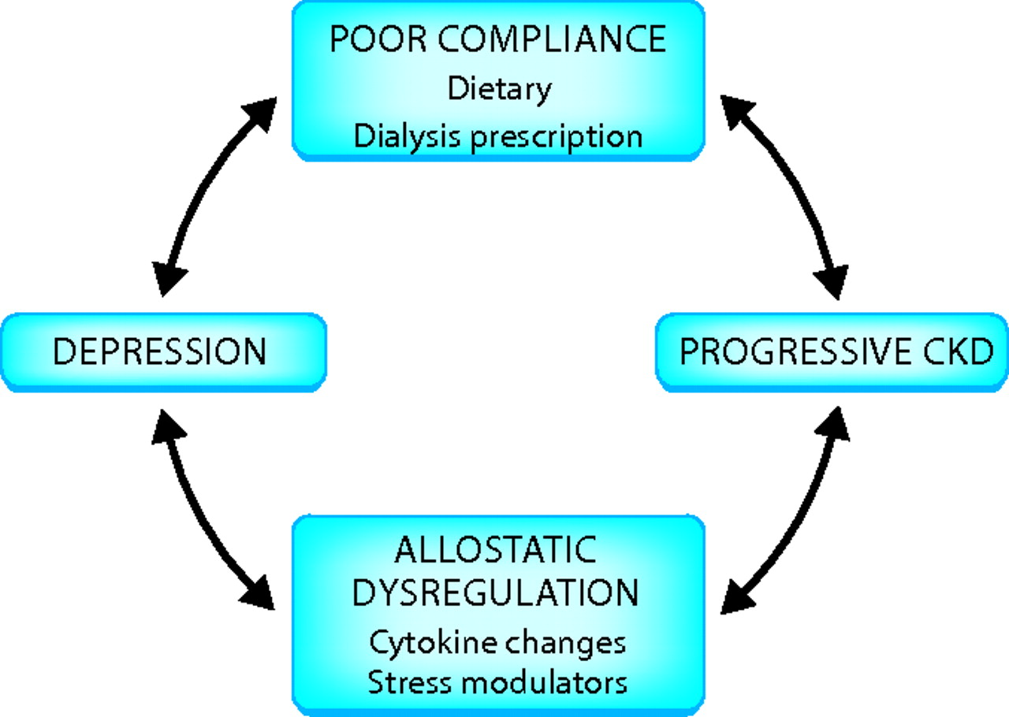
Potential mechanism of vicious cycle between depression and ESRD.
Daniel Cukor et al. JASN 2007;18:3042-3055
Notes:
Potential mechanism of vicious cycle between depression and ESRD.

Slide 16
So How do Renal Patients Respond
Renal failure patients have been noted as the biggest deniers of psychiatric illness.
They often feel that they are over doctored and even motivational psychotherapy is best administered in the dialysis unit itself. Many patients on dialysis do well if individual psychotherapy is administered during the dialysis sessions itself.
Another complication is the nonadherence to the treatment and medical regimens.
Such patients take appointments, but do not visit the doctor and may also get angry on the staff of the dialysis unit.
The dialysis population is not just a cross section of the general population.
This group is skewed in the direction of the noncompliant diabetic, noncompliant hypertensive and also the alcoholic.
These patients often express their anger as they feel that many others lead a normal life, while they have to suffer and undergo repeated medical procedures.

Slide 17
How to Meet the Requirements in a Different Way
It adds extra time and staff effort to screen in the dialysis facility
There is no additional reimbursement to the dialysis facility
The revenue for Nephrologist is declining
Nephrologist can complete the screening and testing in the office and receive additional reimbursement
The results of testing can be sent directly to the dialysis facility for inclusion in their records to meet requirements.

Slide 18
The M.I.N.I. In Your Practice – 3 Simple Steps
1
2
M.I.N.I. Screen in Waiting Room (3-5 min.)
Front Desk staff completes patient sign-in process.
Patient is provided with verbal instructions and a tablet to complete M.I.N.I. Screen.
Staff receives results indicating if patient qualifies to take M.I.N.I. Interview.
Or: M.I.N.I. Screen in exam room (3-5 min.)
Nurse/MA completes initial assessment.
Patient is provided with verbal instructions and a tablet to complete M.I.N.I. Screen.
Staff receives results indicating if patient qualifies to take M.I.N.I. Interview.
M.I.N.I. Interview in exam room (10-20 min.)
Nurse/MA provides patient with instructions and a tablet to complete M.I.N.I. Interview.
Results are immediately available for provider review during visit.
Referral
Provider reviews results with patient as part of the visit.
Provider determines if they will treat patient or refer patient based on practice policy/comfort.
Tracker scales are initiated to monitor patient progress and treatment course
3

Slide 19
Diagnostic Tool Comparison
Validated diagnostic neuropsychiatric interviews.
SCID – Structured Clinical Interview for DSM
Takes approximately 90 minutes to administer.
On-site scoring is NOT available.
M.I.N.I. - Mini-International Neuropsychiatric Interview
Most widely used neuropsychiatric diagnostic assessment tool in the world by the World Health Organization.
Takes approximately 15 minutes to administer.
Screens for 17 adult and 24 childhood DSM-5 disorders.
PHQ-9 – Patient Health Questionnaire
It is a public domain, self-administered screening.
Not a diagnostic assessment.

Slide 20
Our Users

Slide 21
Thank You.

