Slide 2
Mission Statement
FSN represents and serves the interests of Florida nephrologists in their pursuit and delivery of quality care for patients with kidney disease.

Slide 3
Strategic Priorities
Education
Regulatory & Legislative Advocacy
Practice Management Success
Patient Care
Grassroots Communication
Collaboration – Partnerships

Slide 4
Association Update
Currently over 285 members
Active Members are Nephrologists
Associate Member category for PAs/ARNPs
Corporate Membership Program

Slide 5
Current Initiatives and Programs

Slide 6
Topics to Cover
MACRA
2016 FL Legislation
FSN MedMal Program
Patient Education – Medicare Advantage Network Adequacy

Slide 7
MACRA Final Rule
Shift to paying for value is here
Significant concern for the impact on small physician practices
Budget neutrality will amplify gulf between the well performing practices versus poor performing practices
50% of physicians have not heard of MACRA – Deloitte Development LLC

Slide 8
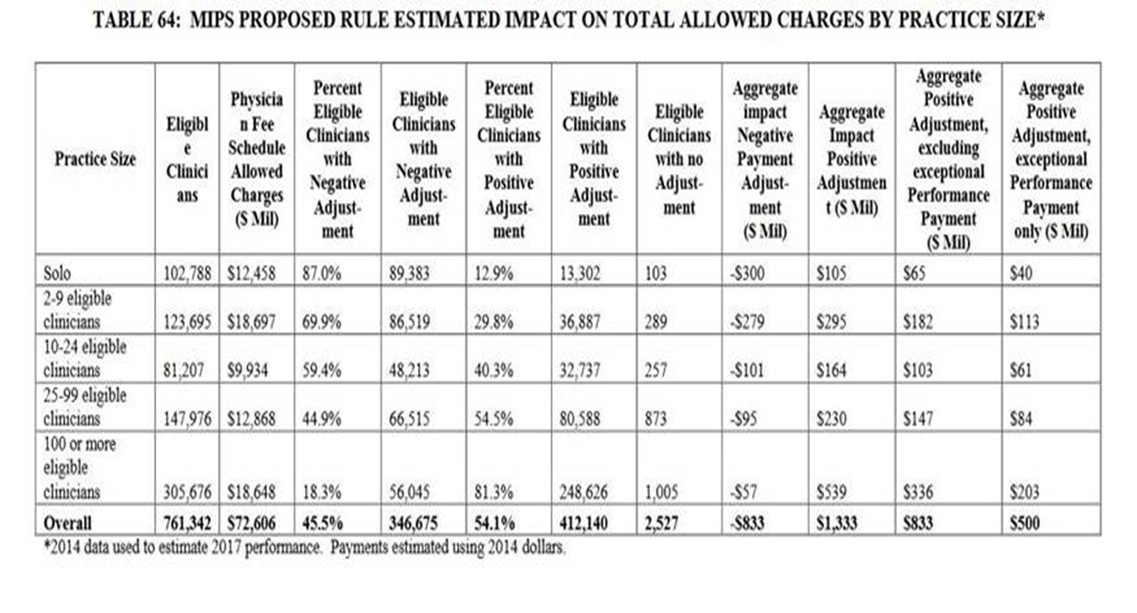

Slide 9
Patrick Conway, MD, MSc
CMS Chief Medical Officer
Impact on Small and Solo Practitioners is a major concern – looking for solutions
Implementation may be phased in – go live date January 1, 2017

Slide 10
Member Assistance
Education and Resources
Two Tracks – Alternative Payment Models or Merit-Based Incentive Payment System
RPA Collaborations
ESCOs
Clinical Quality Data Registry

Slide 11
RPA Continued
2016 Combined Coding & Reimbursement Conference
Taking place at start of the 2016 FSN Annual Meeting in Delray Beach, FL

Slide 12
2016 FL Legislation
Transparency
Out of Network Billing
PA and ARNP Prescribing Controlled Substances

Slide 13
FSN Medical Malpractice Program
75 Members
MedPro is the program partner
Innovative Marketing and Program Features
Facility and physician coverage

Slide 14
This Year’s Challenge?
Patient education on network adequacy for Medicare Advantage plans
Narrow Networks = considerable travel challenges for patients
Resources and awareness for patients during open enrollment periods

Slide 16
Thank you! fcobbe@cobbemanagement.com

